Slide 1
Data 603 Statistical Modelling with Data
(Week 3)
Dr. Qingrun Zhang
Assistant Professor
Department of Mathematics and Statistics
University of Calgary

Slide 2
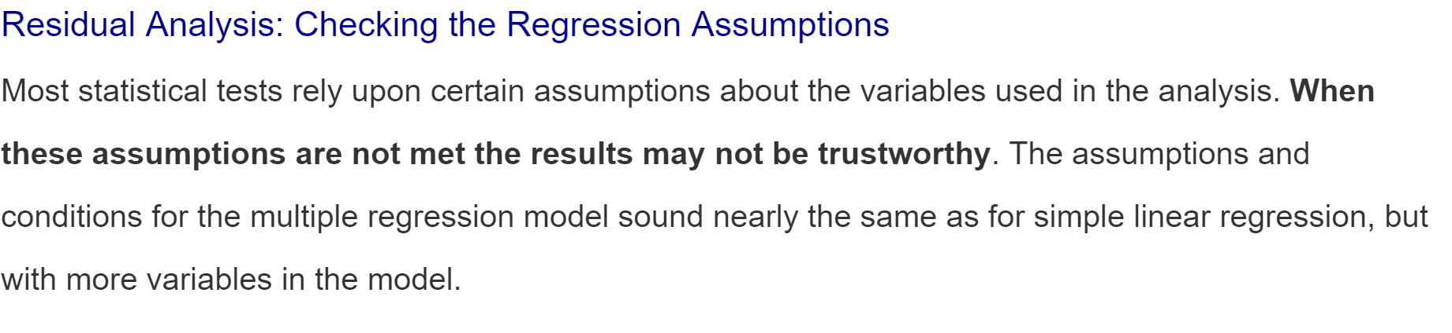
MLR Part 4: Multiple Regression Diagnostics

Slide 3
Assumptions
Linearity Assumption
Independence Assumption
Equal Variance Assumption
Normality Assumption
Multicollinearity
Outlier

Slide 4
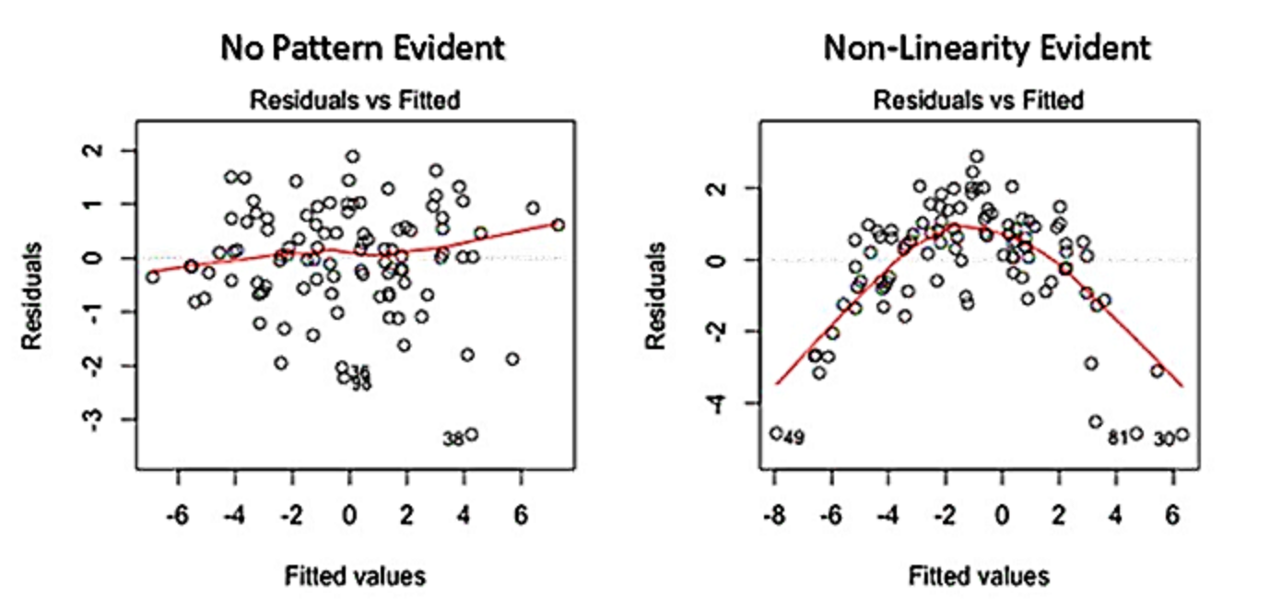
1. Linearity Assumption
The linear regression model assumes that there is a straight-line relationship between the predictors and the response. If the true relationship is far from linear, then virtually all of the conclusions that we draw from the fit are suspect. In addition, the prediction accuracy of the model can be significantly reduced.
If the residual plot indicates that there are non-linear associations in the data, then a simple approach is to use non-linear transformations of the predictors, such as log(X), Sqrt(X), and X^2 in the regression model.

Slide 5

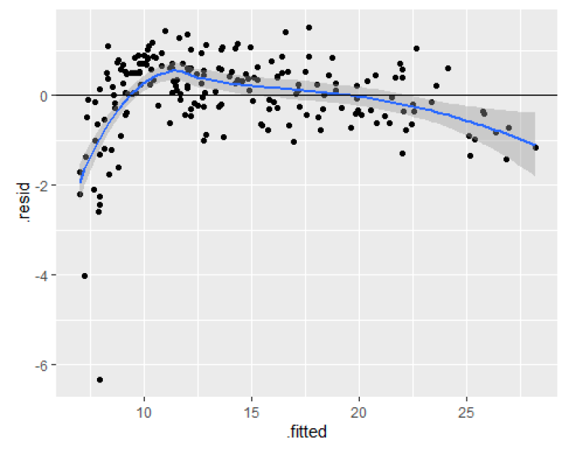
Advertising data

Slide 6
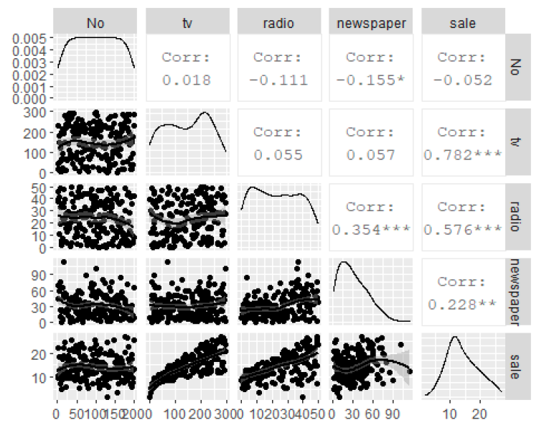
Advertising data: Pairwise correlation

Slide 7
Advertising data- Linear Model

Slide 8
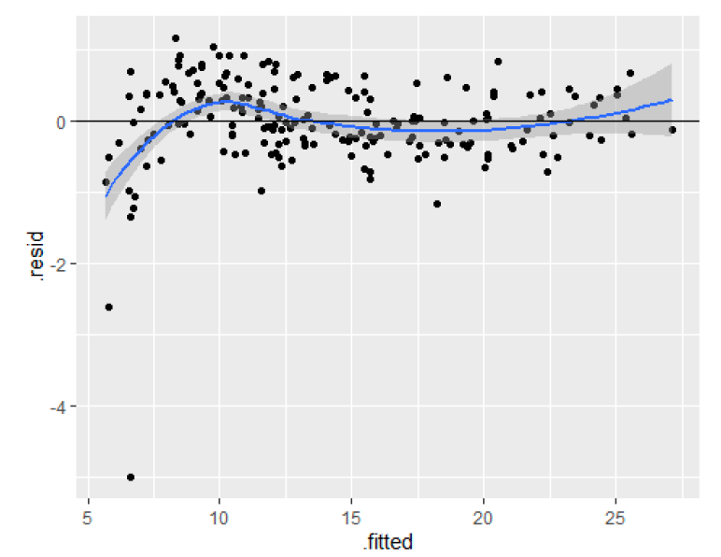
Advertising data- Quadratic model

Slide 9
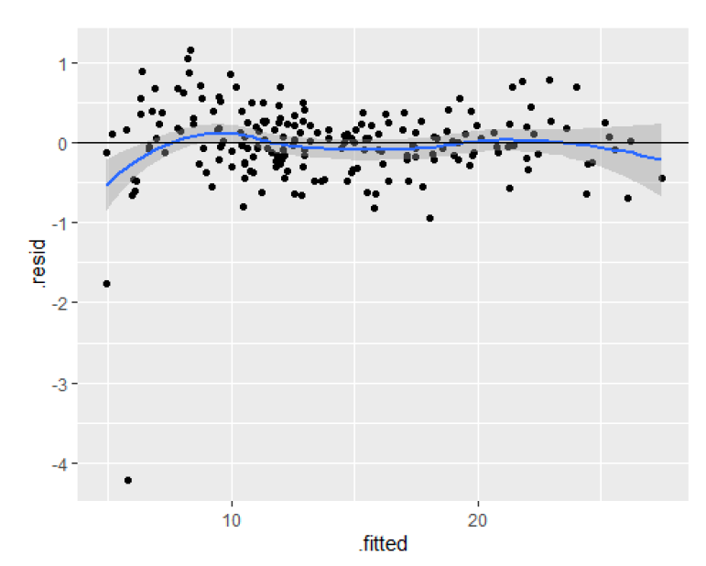
Advertising data - Cubic model

Slide 10

In-Class Practice Problem 16
From the clerical staff work hours, use residual plots to conduct a residual analysis of the data. Check Linearity Assumption. If a trend is detected, how would you like to transform the predictors in the model?
ggplot(model, aes(x=…., y=…)): mapping 2 variables on a and y axis
.fitted : Fitted values of model
.resid : Residuals
geom_hline(yintercept = 0):add a horizontal line
geom_point() : add a layer of points to the plot

Slide 11
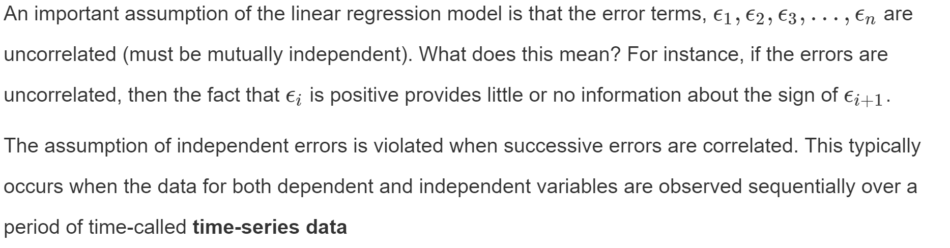
2. Independence Assumption

Slide 12
Independence Assumption
Lack of independence can be caused by:
Serial correlation
Spatial association
Cluster effect
Make plots of residuals vs relevant explanatory variables and look for pattern
Residuals vs time (or observation number)
Residuals vs spatial variable
Residuals vs group (prefer blocking)
Well, how do I quantify this? ☹

Slide 13
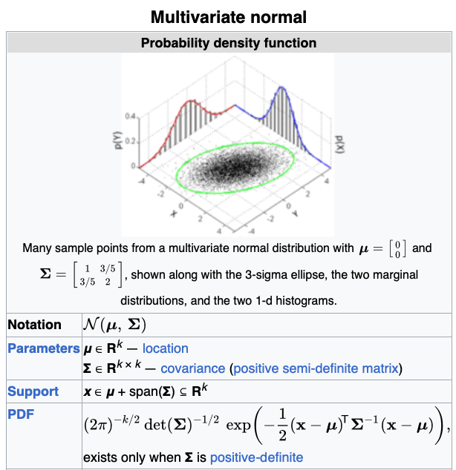
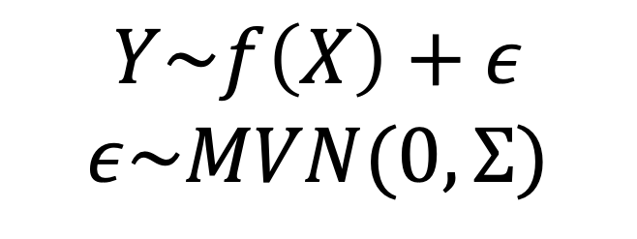

An example using multivariate normal distribution
$$Y\sim f\left(X\right)+ε$$
$$ε\sim MVN(0, Σ)$$
Where $Σ$ is the person-to-person similarity matrix

Slide 14
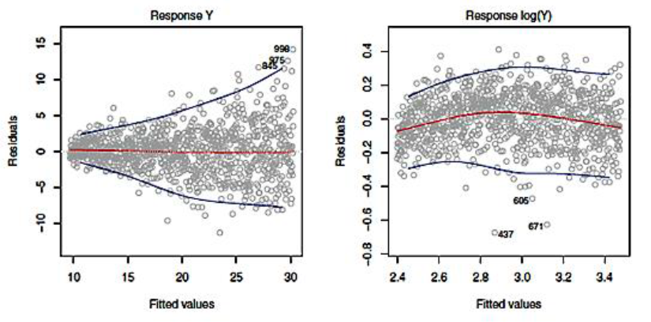
3. Equal Variance Assumption
Constant variance of the errors (homoscedasticity),

Slide 15
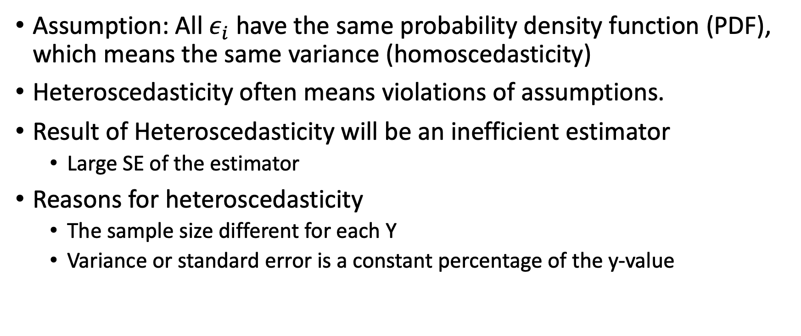
Heteroscedasticity
Assumption: All $ε_{i}$have the same probability density function (PDF), which means the same variance (homoscedasticity)
Heteroscedasticity often means violations of assumptions.
Result of Heteroscedasticity will be an inefficient estimator
Large SE of the estimator
Reasons for heteroscedasticity
The sample size different for each Y
Variance or standard error is a constant percentage of the y-value

Slide 16
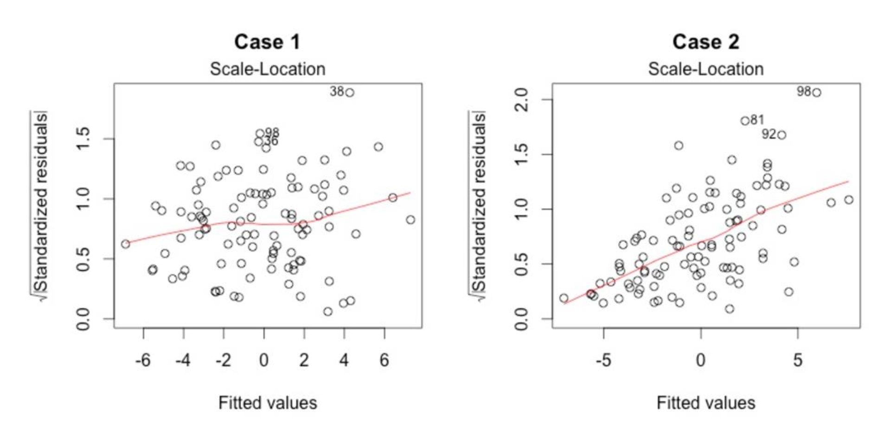
The scale location plot

Slide 17
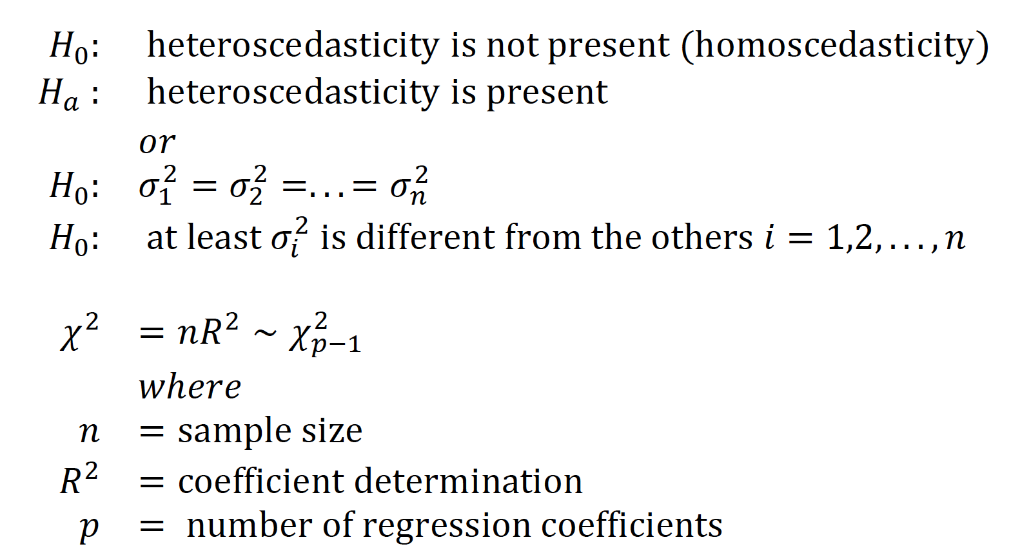
The Breusch-Pagan Test

Slide 18
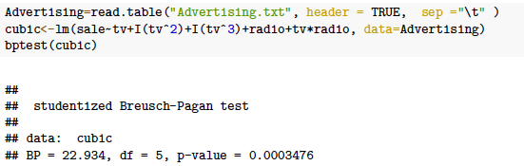
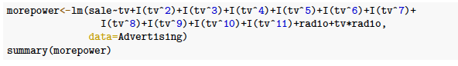
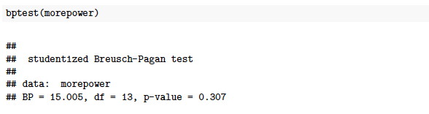
An example: more thorough fit

Slide 19
How to deal with heteroscedasticity
If you know how the variance changes with each sample
Weighted Least Square Regression
If the variance has unknown dependence on y_{i}
Other regression methods (GMM, generalized method of moments estimation)
If you know the general trend of variance change with the predictor variable, then you can transform the data
Log-transformation
Box-Cox transformations
These will be studied later…

Slide 20
In-Class Practice Problem 17
From the clerical staff work hours, use residual plots to conduct a residual analysis of the data. Check Equal Variance Assumption by graphs and the Breusch-Pagan test. If you detect a trend, how would you like to transform the predictors in the model?

Slide 21
4. Normality Assumption
Errors should be normally distributed.
Histogram
Normal probability plot
Q-Q plot
Kolmogorov-Smirnov test
Shapiro-Wilk test

Slide 22
Skewness & Kurtosis
Skewness is a measure of symmetry, or more precisely, the lack of symmetry
Kurtosis is a measure of whether the data are heavy-tailed or light-tailed relative to a normal distribution.
Data sets with high kurtosis tend to have heavy tails, or outliers.
Data sets with low kurtosis tend to have light tails, or lack of outliers.
The histogram is an effective graphical technique for showing both the skewness and kurtosis of data set.

Slide 23
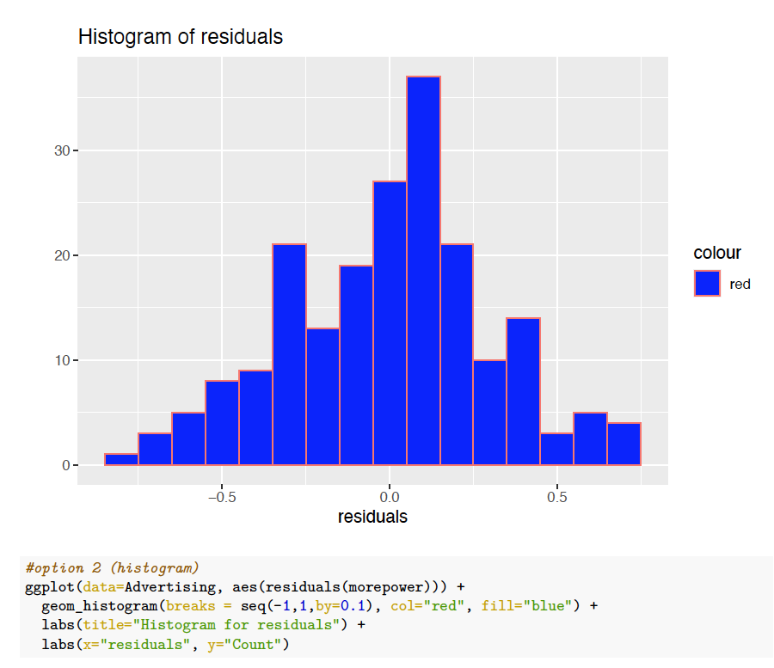
Histogram

Slide 24
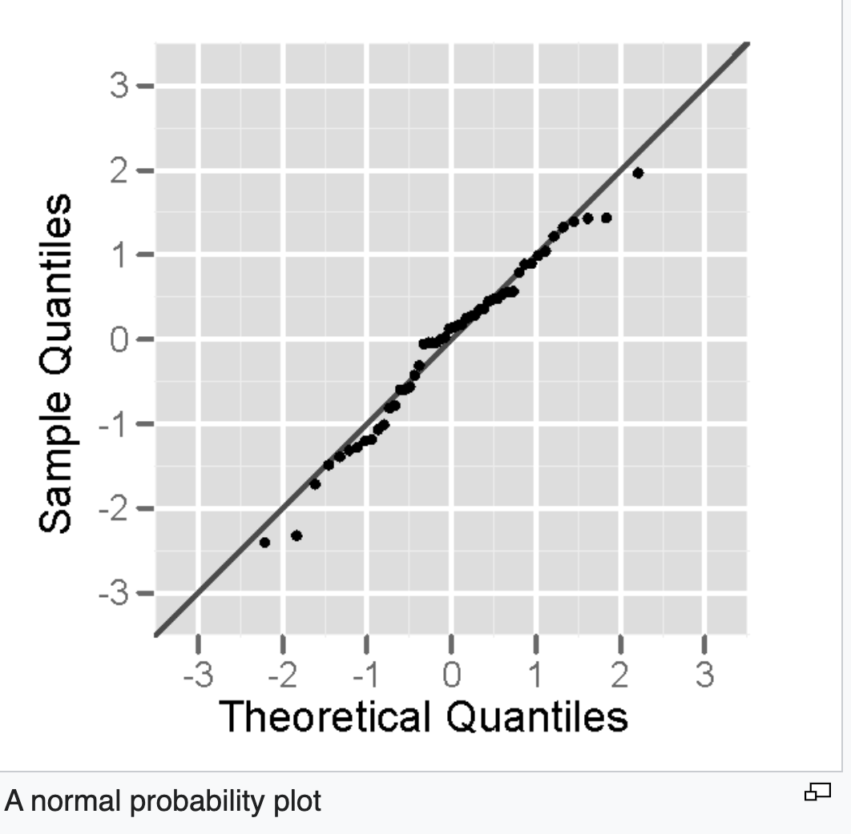
Normal Probability Plot

Slide 25
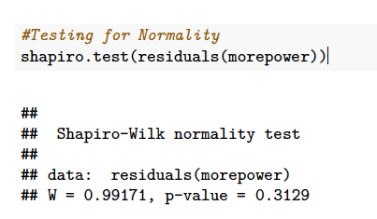
Shapiro Wilk Test

Slide 26
In-Class Practice Problem 18
From the clerical staff work hours, use residual plots to conduct a residual analysis of the data. Check Normality Assumption by graphs and the Shapiro-Wilk normality test. If you detect a trend, how would you like to transform the predictors in the model?

Slide 27
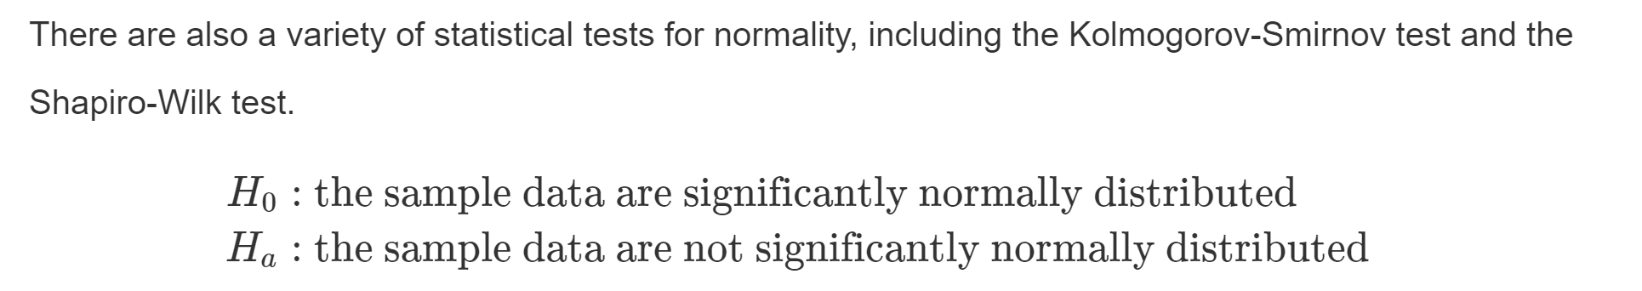
Normality Assumption(Cont.)
ggplot() : plot a graph
stat_qq() : produce quantile-quantile plots
stat_qq_line() : compute the slope and intercept of the line connecting the points at specified quartiles of the theoretical and sample distributions
shapiro.test() : to perform the Shapiro-Wilk test

Slide 28
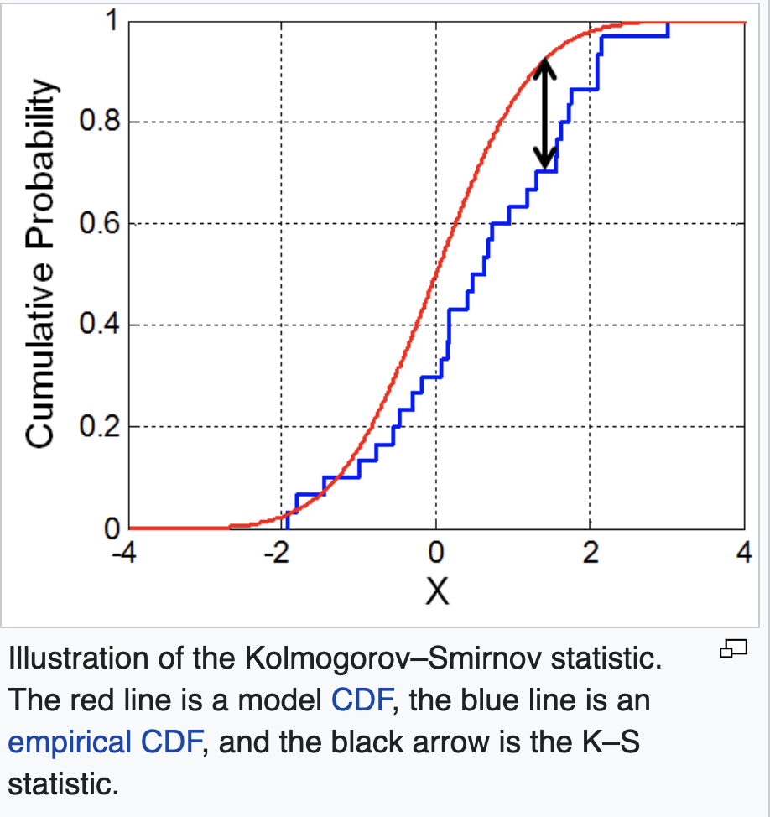
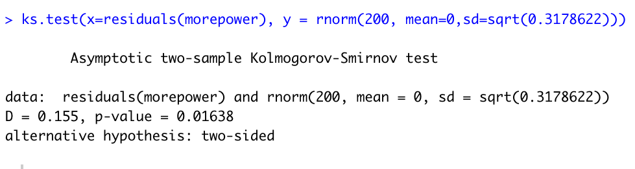
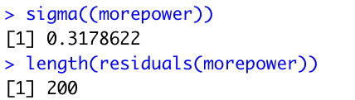
Kolmogorov-Smirnov test

Slide 29
Differences
S-W test is a modification of the Kolmogorov-Smirnov (K-S test) and gives more weight to the tails of the distribution than does the K-S test.
The K-S test is distribution free in the sense that the critical values do not depend on the specific distribution being tested.

Slide 30
5. Multicollinearity
Often, two or more of the independent variables used in the model for E(Y) provide redundant information.
That is, the independent variables will be correlated with each other. When the independent variables are (linearly) correlated, we say that multicollinearity exists. In practice, it is not uncommon to observe correlations among the independent variables. However, a few problems arise when serious multicollinearity is present in the regression analysis.
What Problems Do Multicollinearity Cause?
The coefficient estimates can swing wildly based on which other independent variables are in the model. The coefficients become very sensitive to small changes in the model.
Multicollinearity reduces the precision of the estimate coefficients, which weakens the statistical power of your regression model. You might not be able to trust the p-values to identify independent variables that are statistically significant.

Slide 31
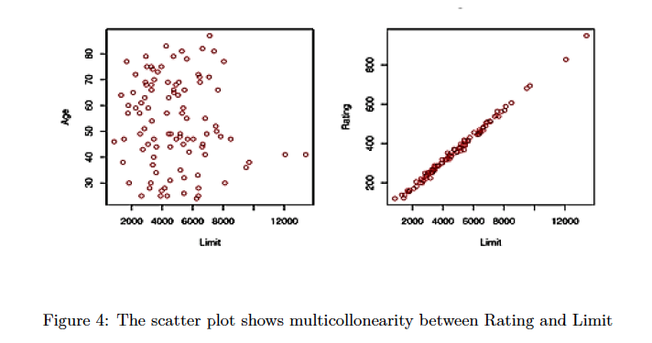
An example:

Slide 32
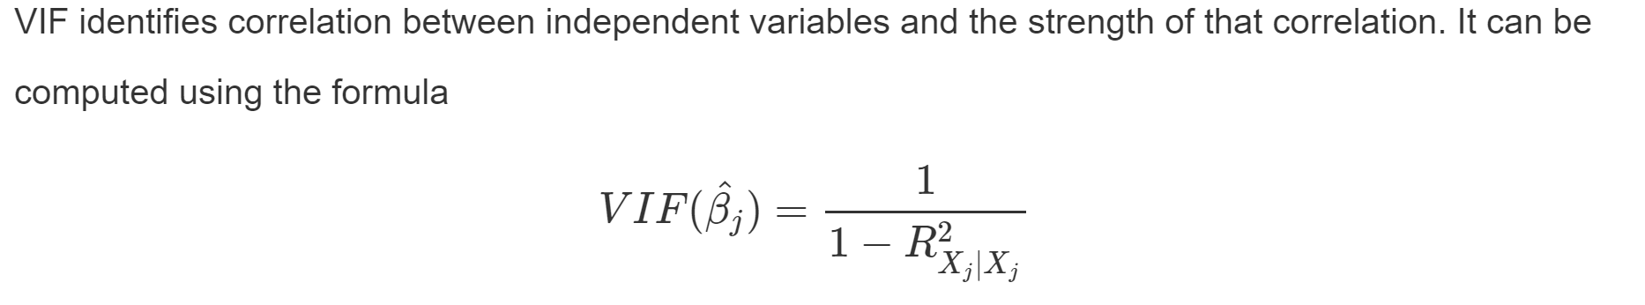
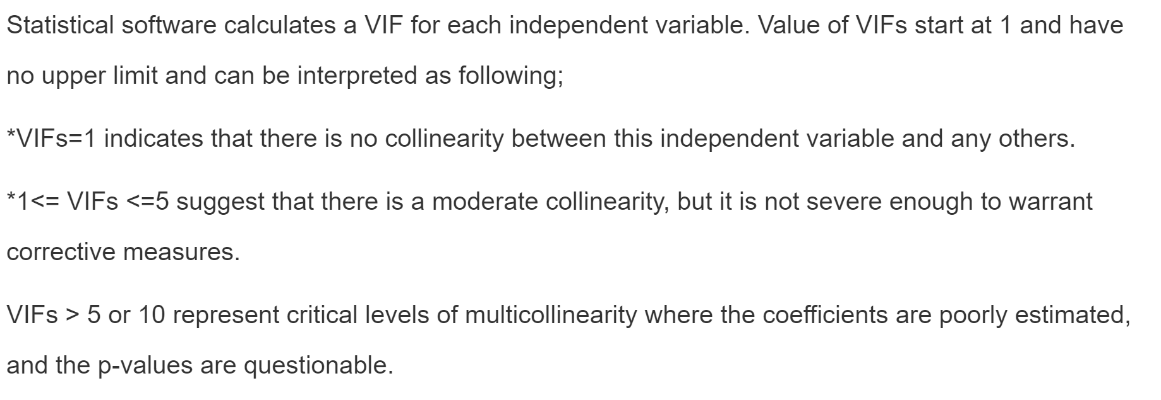
Testing for Multicollinearity with Variance Inflation Factors (VIF)

Slide 33
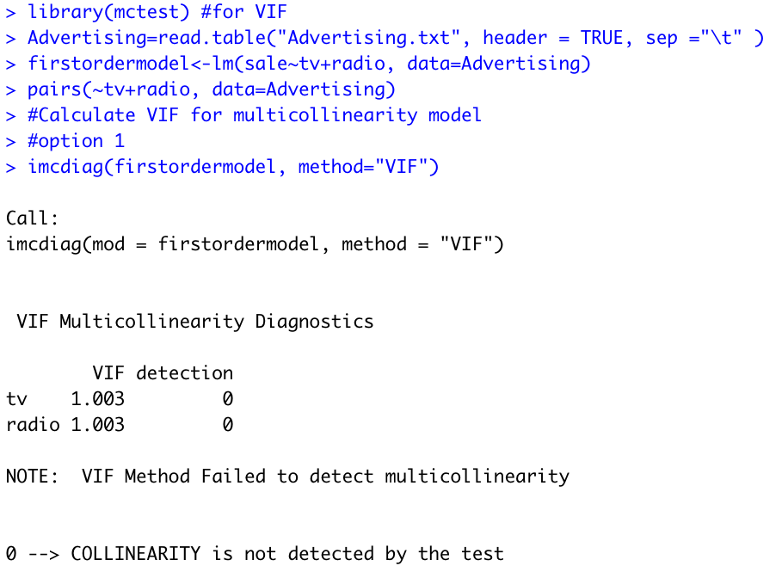
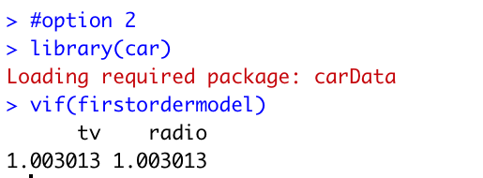
An example:

Slide 34
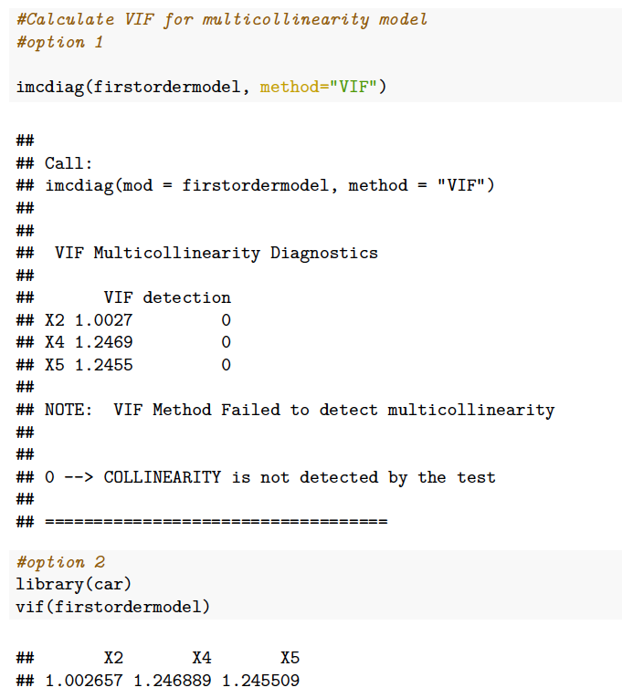
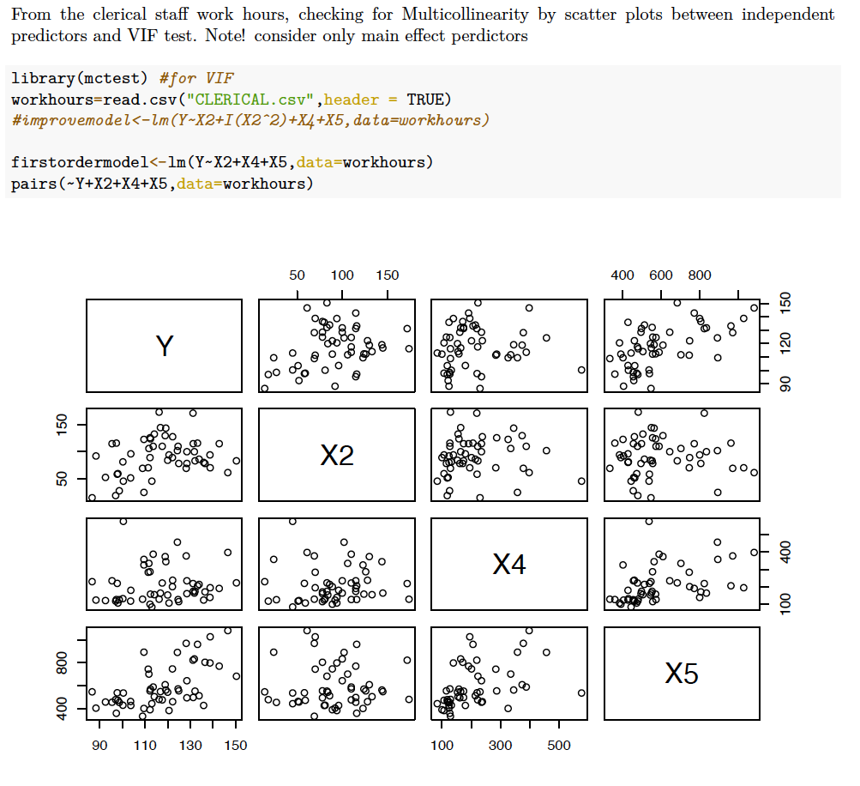
Another example:

Slide 35
In-Class Practice Problem 19
From the credit card example, check for Multicollinearity by scatter plots between independent predictors and VIF test . Note! consider only main effect predictors
pairs():produce a plot matrix, consisting of scatterplots for each variable combination of a data frame.
imcdiag(x=,y=,method=“VIF”) : detects the existence of multicollinearity due to independent variables

Slide 36
Solutions for Multicollinearity
The first solution is to drop one of the problematic variables from the regression model.
The second solution is to combine the collinear variables together into a single predictor.

Slide 37
In-Class Practice Problem 20

Slide 38
6. Outlier (The effect on individual cases)
Outlier: An outlying case is defined as a particular observation (𝑌,𝑋1,𝑋2,...𝑋𝑝) that differs from the majority of the cases in the data set. Potentially caused by a different mechanism (something might wrong)
Possible causes of outliers
Error in recording data (e.g. 28 to 82)
Measurement process/tool problem
Failure of the experimental process
For non-robust statistics, outlier can ruin the analysis. (e.g. mean)

Slide 39
Several key concepts
Outliers: a point that falls far from the other data points.
Leverage: High-leverage points are those observations, if any, made at extreme or outlying values of the independent variables
Influential: If the parameter estimates change dramatically when a point is removed, that point is influential
How influential a point is, is a combination of how much leverage it has and how extreme it is in the y-direction.

Slide 40
Leverage & influence
High leverage, high influence
Low Leverage, some influence

Slide 41
Leverage & influence
High leverage, how influence
What to do with influential point?
Make sure the observation is correctly recorded.
Do the conclusions change?
Can we get more observations near that value of X?

Slide 42
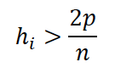
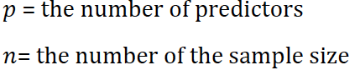
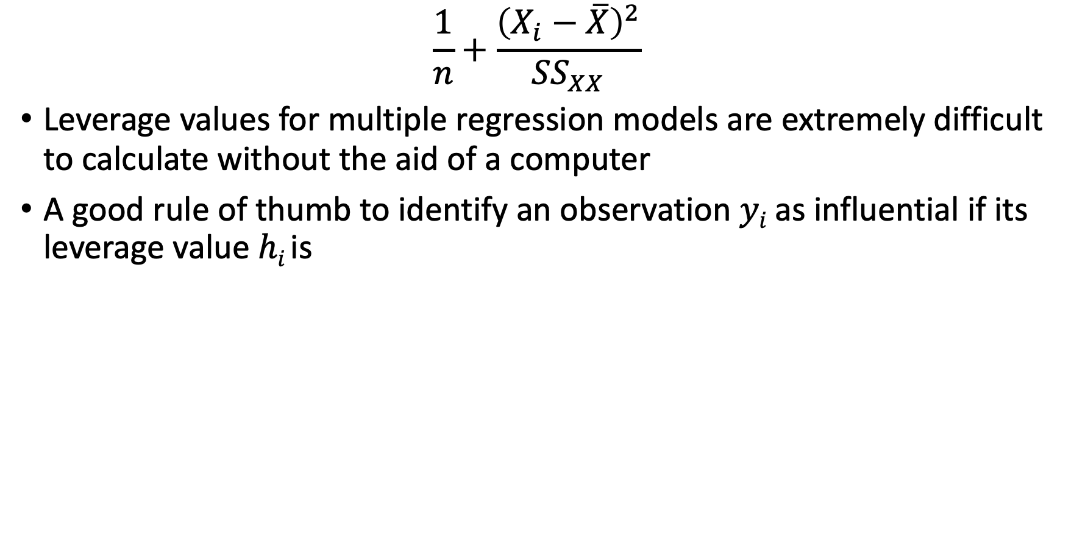
Numeric measures for leverage
$$\frac{1}{n}+\frac{{\left(X_{i}−\overline{X}\right)}^{2}}{{SS}_{XX}}$$
Leverage values for multiple regression models are extremely difficult to calculate without the aid of a computer
A good rule of thumb to identify an observation 𝑦_{𝑖} as influential if its leverage value ℎ_{𝑖} is

Slide 43
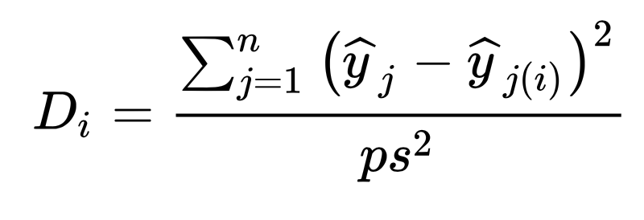
Numeric measure for influence
Cook’s Distance
S is the mean square error of the regression model. p is the number of the parameters in the model

Slide 44
Cook’s Distance
The Cook’s distance 𝐷_{𝑖} measures the effect of deleting a given observation.
A large value of 𝐷_{𝑖} indicates that the observed 𝑌_{𝑖} value has strong influence on the estimated coefficients
A general rule of thumb is that observations with a Cook’s 𝐷 of more than 3 times the mean, 𝜇, is a possible outlier.
An alternative interpretation is to investigate any point over 4/𝑛, where 𝑛 is the number of observations

Slide 45
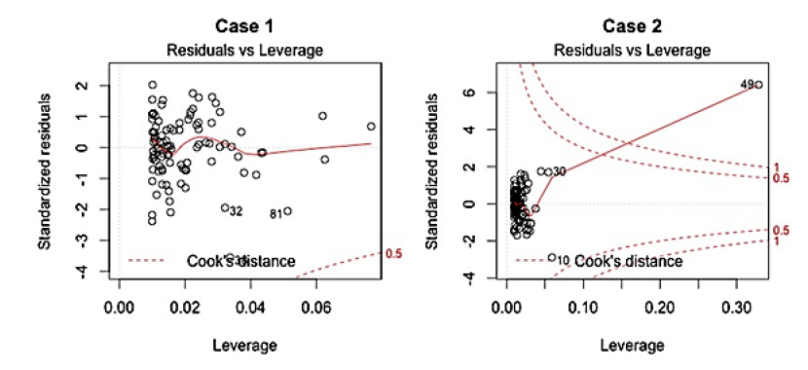
Residuals vs Leverage plot
This plot helps us to find influential cases

Slide 46
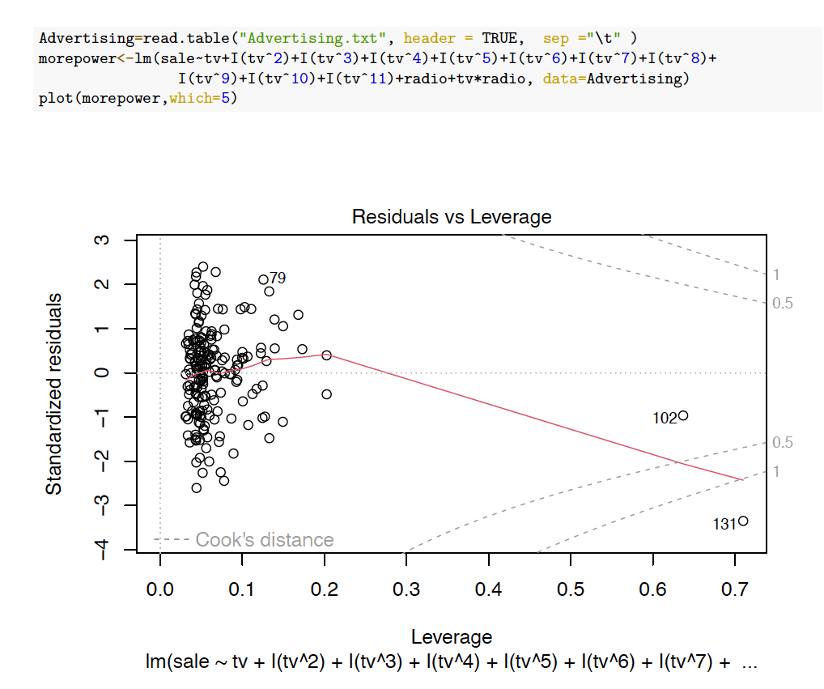
An example using Advertising data

Slide 47
Which()
Which selects which plot to be displayed:
A plot of residuals against fitted values
A normal Q-Q plot
A Scale-Location plot of sqrt(| residuals |) against fitted values
A plot of Cook's distances versus row labels
A plot of residuals against leverages
A plot of Cook's distances against leverage/(1-leverage)

Slide 48
Leverage points

Slide 49
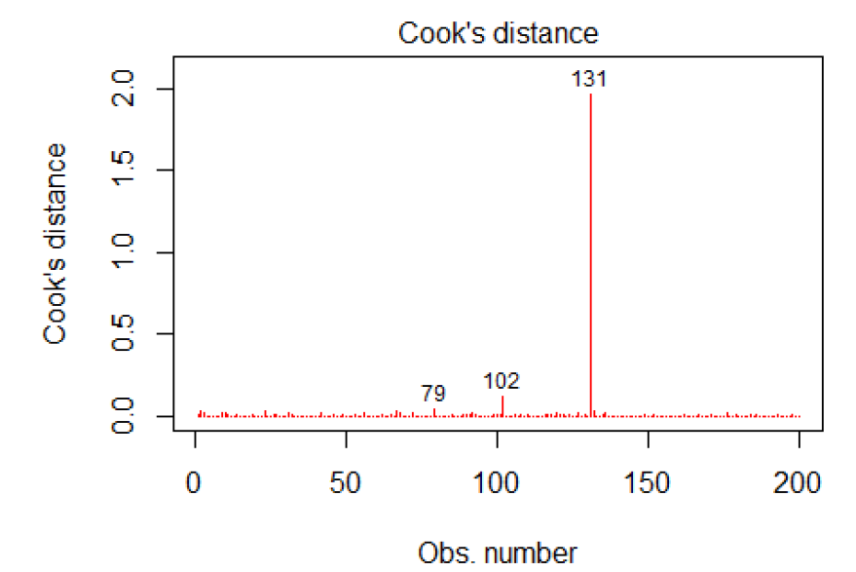
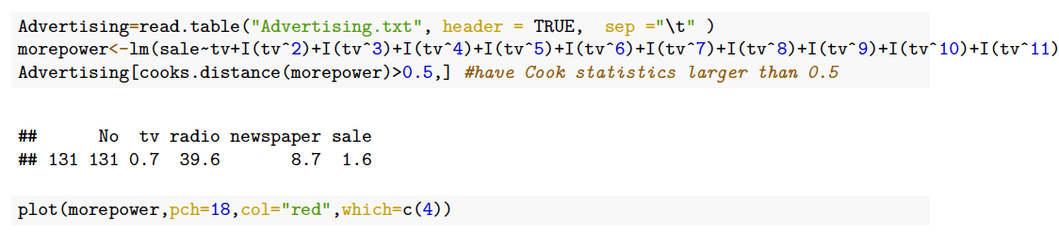
Cook’s distance

Slide 50
In-Class Practice Problem 21 & 22

Slide 51
What to do with outlier
It is always good to identify outliers for the lessons that we can learn.
Investigate these cases separately, to learn the potential reason.
Check what will happen when we exclude the outlier form the model.

Slide 52
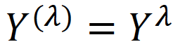
Transformations
Logarithm transformation: If y goes exponentially or as a power of x, transform by taking the log
Square root transformation: If data exhibiting a Poisson distribution (variance =mean), transform by taking the square root.
Box-Cox transformation: a family of power transformation.
where 𝜆 is a parameter to be determined using the data, vairies from -5 to 5

Slide 53
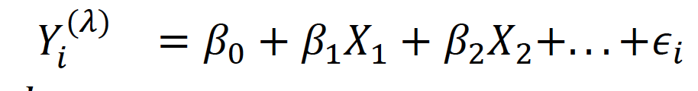
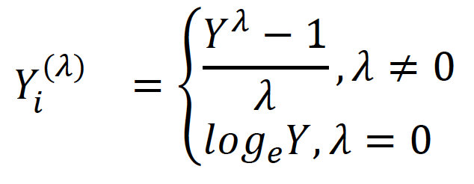
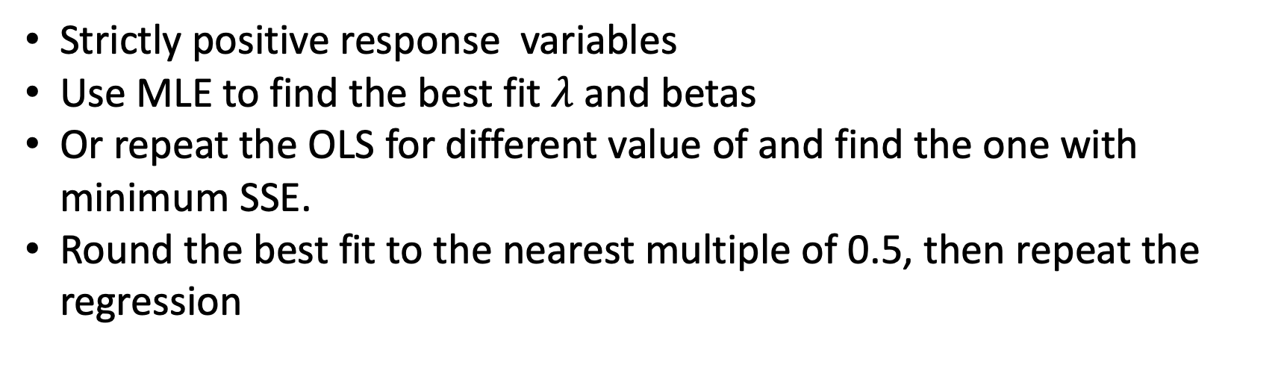
Box-Cox Transformation
Strictly positive response variables
Use MLE to find the best fit $λ$ and betas
Or repeat the OLS for different value of and find the one with minimum SSE.
Round the best fit to the nearest multiple of 0.5, then repeat the regression

Slide 54
The example R code for two datasets

Slide 55
Important points about OLS regression
There must be linear relationship between independent and dependent variables
Multiple regression suffers from multicollinearity and heteroskedasticity
Linear Regression is very sensitive to Outliers. It can terribly affect the regression line and eventually the forecasted values
Multicollinearity can increase the variance of the coefficient estimates and make the estimates very sensitive to minor changes in the model. The result is that the coefficient estimates are unstable.

Slide 56
The example R code for the dataset

